Slide 1
Simple Game

Slide 2
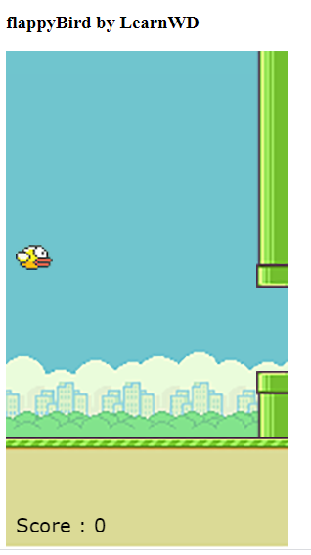
Flappy Birds web browser version

Slide 3
Using canvas
Canvas is used to help drawing graphic on webpage using javascript
To get more details about it: https://www.w3schools.com/html/html5_canvas.asp

Slide 4
Adding images and audio
Each game contains images that will represent objects moving on the screen
Interaction of those objects will make players experience good or bad
In this case we will use images instead of rectangles
So on game start all the images should be read
Then when something happens, audio sound will play too
That means js will read the audio files as well

Slide 5
How game works
We should have a loop that will allow making the movement of the object(s)
We should draw the image on every frame
We will define the draw function
Draw function will do the drawing of background, of bird and pipes / obstacles
Each fraction of the second we move our objects, and we should redraw all the elements.
Here we use requestAnimationFrame() function to help make changes on each frame

Slide 6
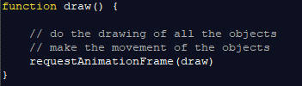
How game works
When we call the function requestAnimationFrame() , we need to provide it the argument. That argument should be our draw function!
So we will have something like this:
This is called recursion!

Slide 7
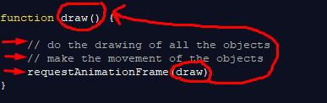
Recursion

Slide 8
So let’s try it
Let’s make the game
We can try checking first the example from the internet and then see if we want to use the same logic or not
However I suggest to use the same images and sounds to save time

